Slide 1
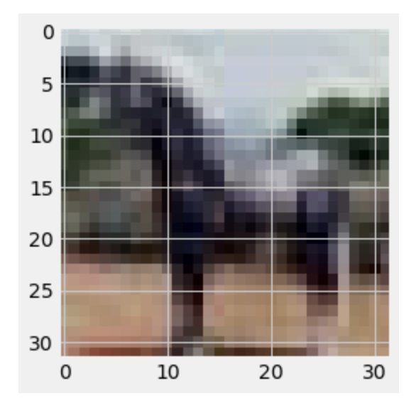
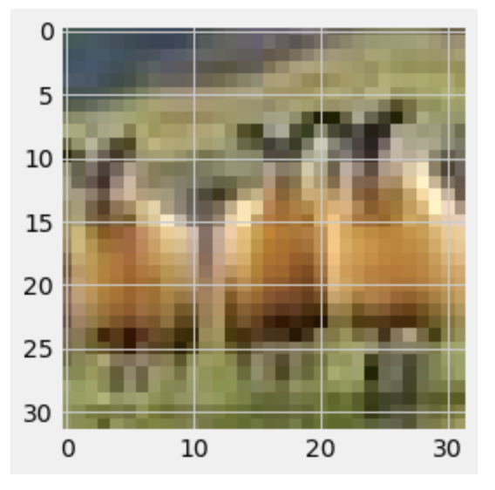
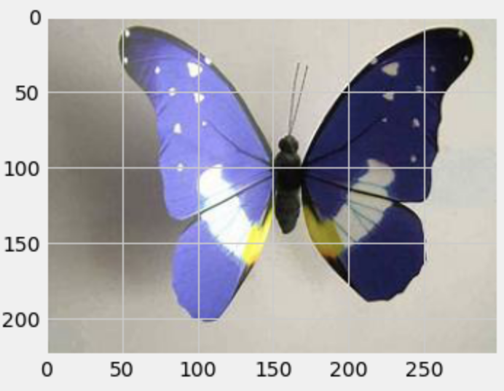
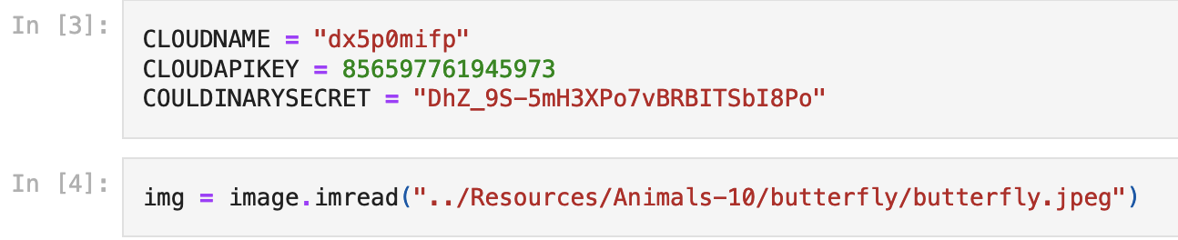
Ani-ML Recognition
Group 5

Slide 2
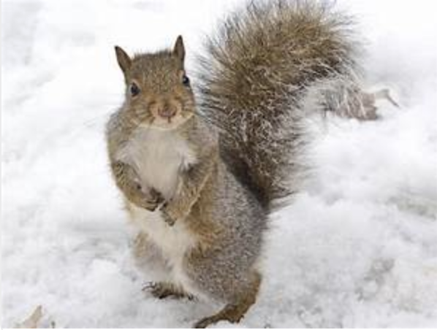
Group Members
Brian Hall
Daniel Webber
David Nguyen
Gautam Iyer
James Dellinger
Joe Johnson
Pradip Raodeo
William Tecchio

Slide 3
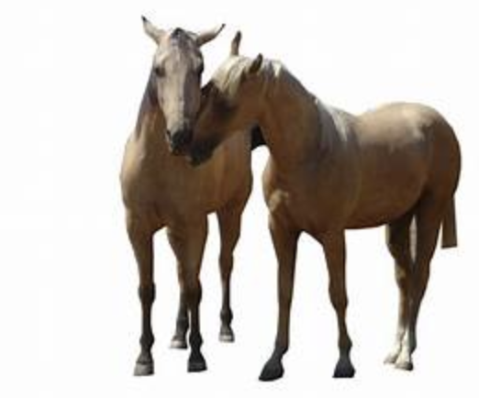
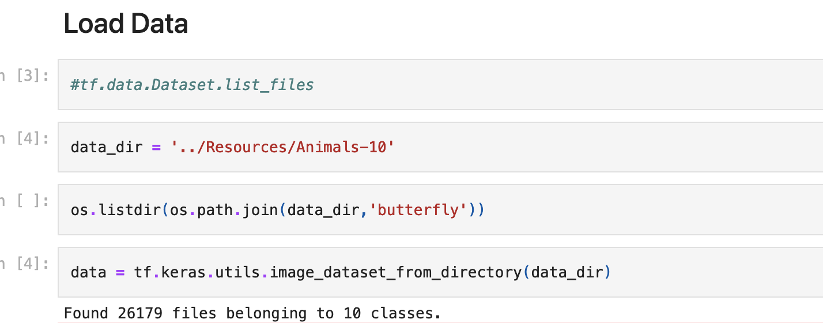
Objectives
Create a machine learning model which can accurately identify a picture as being one of ten animals. The list of ten animals consists of: butterfly; cat; chicken; cow; dog; elephant; horse, sheep; spider; and squirrel.
Design a website that displays our findings for images utilized to run through our model.
Understand the levels of accuracy for our model and quantify it.

Slide 4
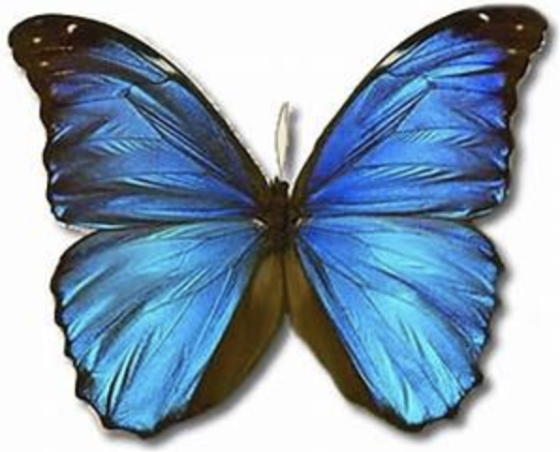
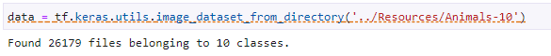
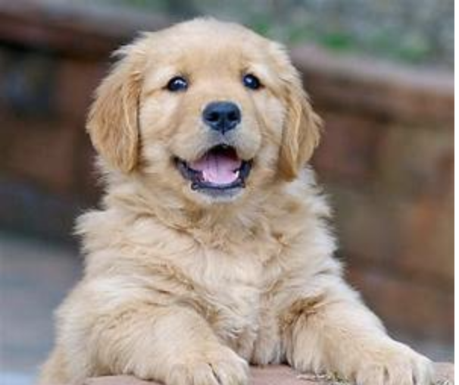
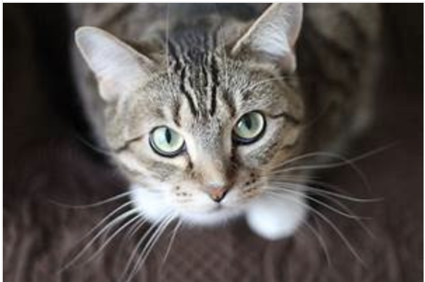
Resources
Kaggle Animals-10 Dataset:
https://www.kaggle.com/datasets/viratkothari/animal10

Slide 5
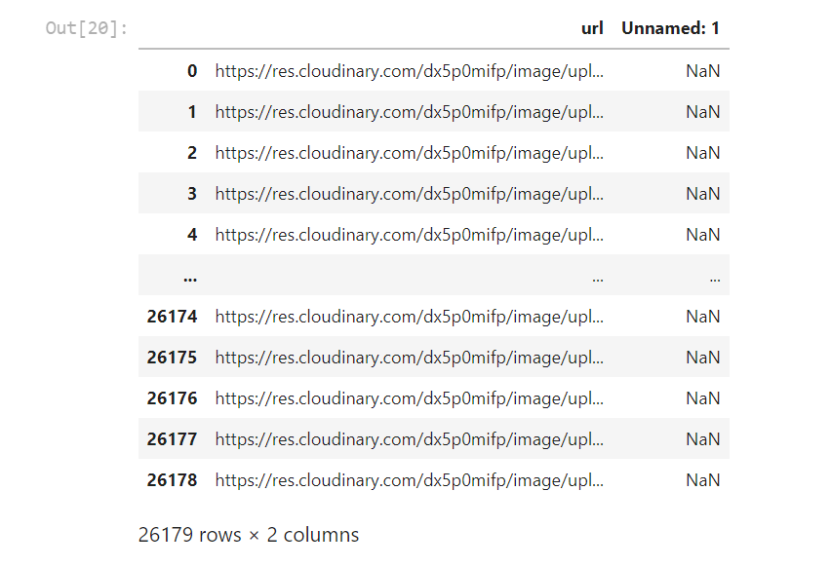
Training Model
Found data source on Kaggle.
Initially utilized Cloudinary to convert images to 32x32 pixels.
Uploaded and stored on MongoDB for later training.
We used Keras to train the model using the RGB and pixel data for the individual images in the dataset.
Utilized TensorFlow to build the model to classify the images.

Slide 6
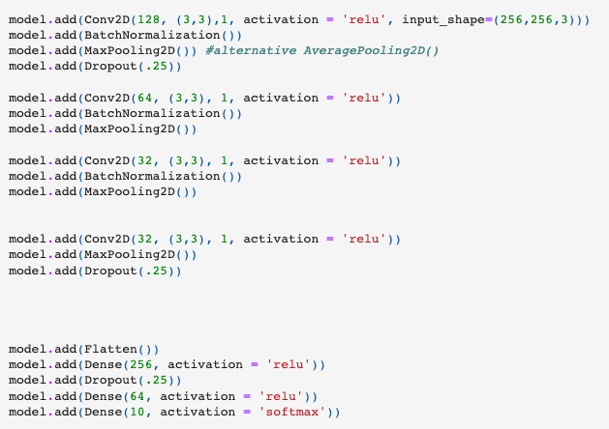
Animal Classification Neural Network
The most important layers for this Neural Network are the Conv2D layers, which is a class to implement the convolution function to 2D inputs, such as images
MaxPooling2D was another important layer for the ML model because this layer interprets spital data
Dropout layers helped remove bias from certain layers of the model
The rest was many, many, many hours of trial and error!

Slide 7
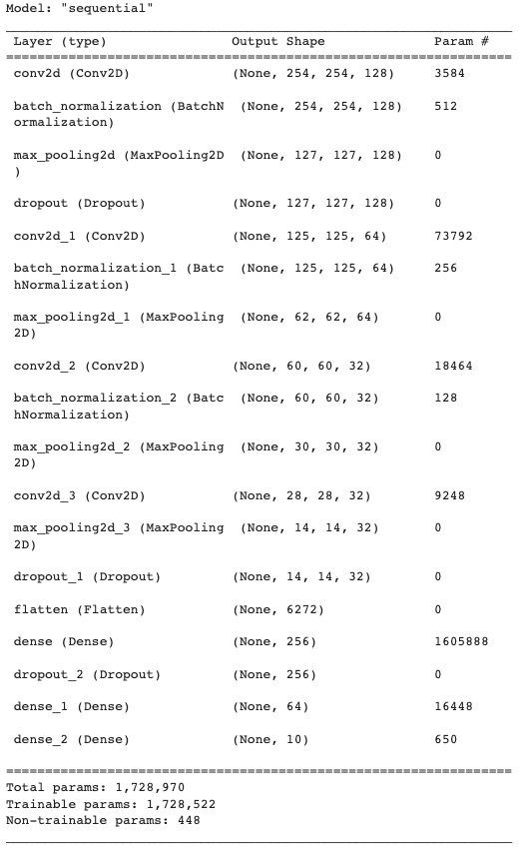
Animal Classification Neural Network Model Summary

Slide 8
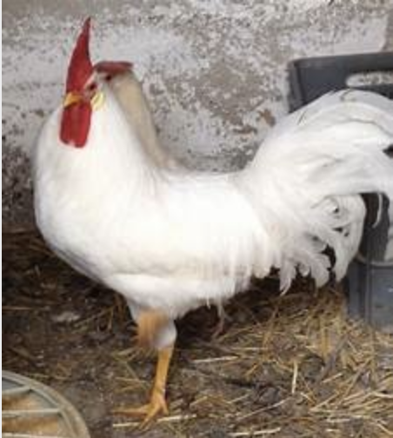
Roadblocks
To list a few…
Cloud Storage
Our Cloudinary database only allowed for 25 GB of storage with a free account, but with more than 1000 images of medium resolution for each animal, we were exceeding it, so we scaled images down to the minimum necessary size (32x32px) and uploaded just the training set first
Uploading to MongoDB Boogaloo
MongoDB only allowed for uploads in 512 MB chunks, so we uploaded the individual folders of images in separate chunks for each animal (db containing collections by animal)
Data Structures (Tensors to Arrays)
The data type / structure the images were stored in the database were not compatible with TensorFlow. The solution was to upload image files with a Keras function to preprocess the pixel data and finally fit to our model.

Slide 9
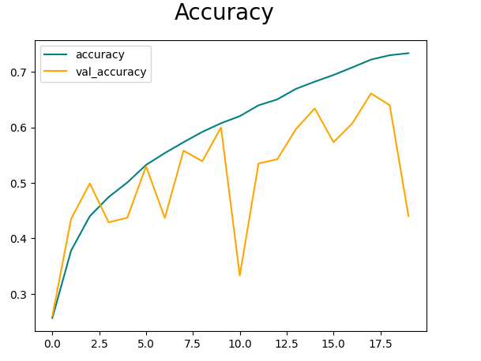
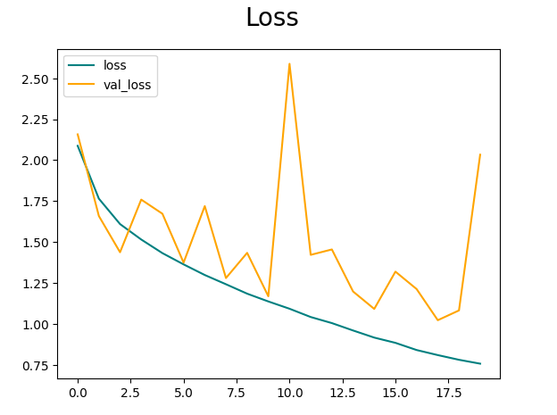
ML Roadblocks
Some very noticeable problems with our V1 model is shown with the accuracy and loss models
The rate of change of the validation values is too high, causing massive spikes as well as a different converging values of test and validation lines
Image occulazation was an idea to determine if the model was correctly finding patterns

Slide 10
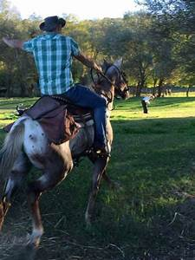
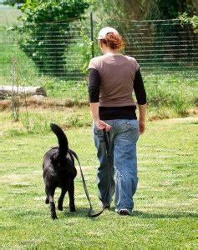
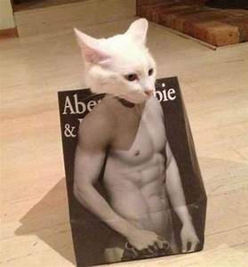
ML RoadBlocks (cont.)
Image occulazation : Notice any patterns? Our model definitely did!

Slide 11
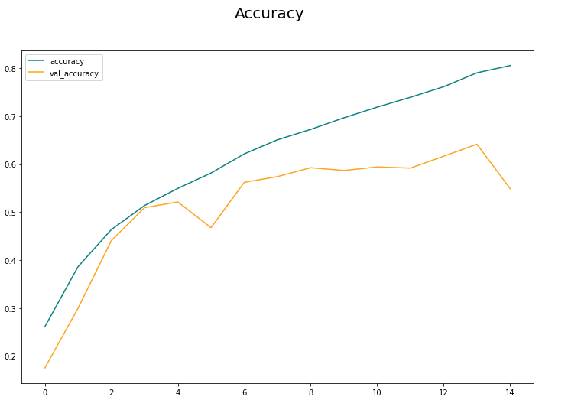
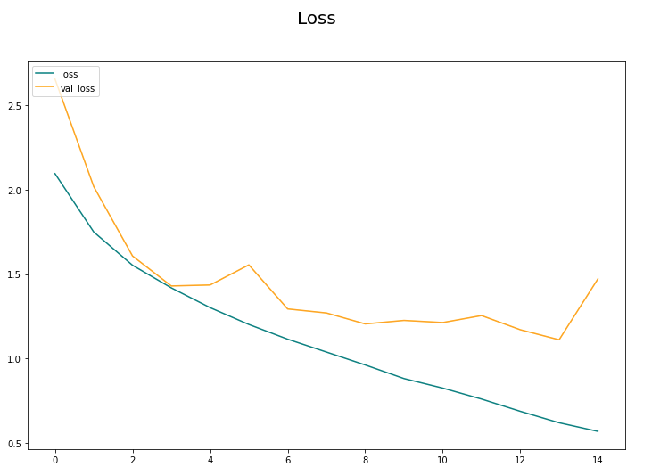
ML Improvements
After reducing the learning rate of the optimizer “sgd” (0.0001), number of batches, and epochs and we were able to see much smoother validation curves.
Much closer converging lines w

Slide 12
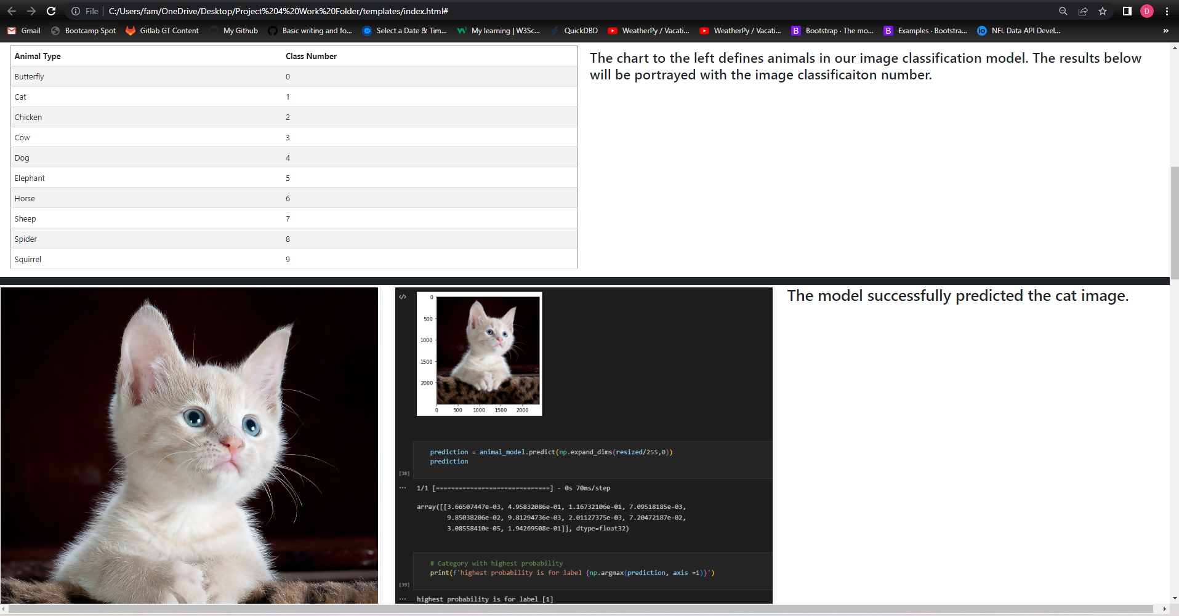
Our Image Processing Website
Notes:
https://webberdan.github.io/project4_site/

Slide 13
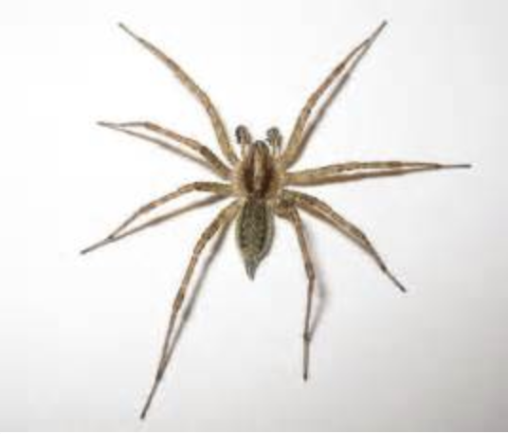
Where Do We Go From Here?
If we were asked to further develop this idea, then what would we do?
Allow users to upload pictures which are not yet in the datasets to our website and have our model attempt to name the animal in the picture.
Upload the user-added image to our database and use it to further train the model. In the case that the model cannot name the animal in the picture, the user would be asked to add a label.
See if the model can classify images of other animals as animals they may look similar to - for example, a giraffe as a horse, or an ant as a spider.
Introduce new animals to the database and model and train it to identify them.

Slide 14
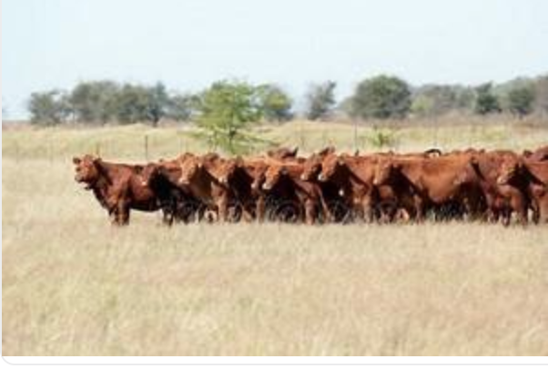
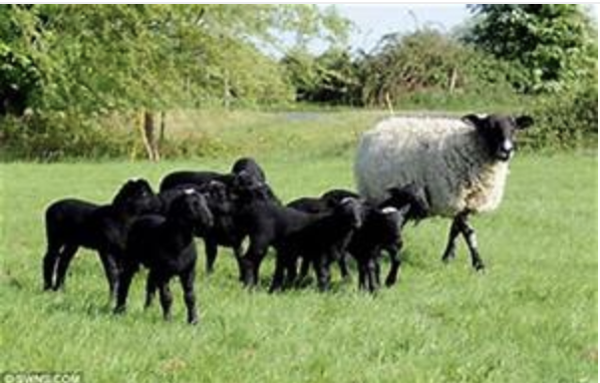
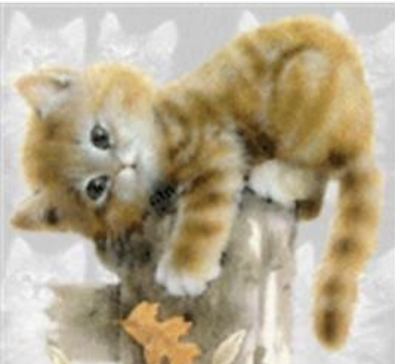
MOO’VE OVER!

